Slide 1
Data Analytics

Slide 2
Data Analysis: What You’ll learn
Business dictionary
Data
Data team
Business intelligence
Data science
Business analytics
Data analytics

Slide 3
?
Analysis Analytics

Slide 4
Analysis
Past
How something happened?
Why something happened?

Slide 5
Analytics
Future
Explores potential future events

Slide 6
Analytics
Qualitative
Quantitative
intuition + analysis
formulas + algorithm

Slide 7
Analysis
Analytics
data analysis
data analytics
business analysis
business analytics

Slide 8




Data & Data teams
Raw Data (Primary Data)
Processed Data (Information)
Actual data from the source
- Numbers, textfiles, images, audio, video,etc
Stored “as is”
May have errors and inconsistencies.
Assessed for relevance, correctness and consistency
Aggregated
Sorted and Categorized
Transformed
Summarized
Visualized

Slide 9
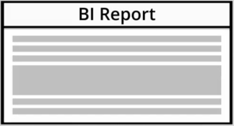
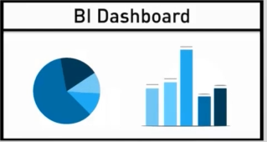
Business Intelligence (BI)
The process of analysing, understanding and reporting historical business data
make decisions
extract insights
extract ideas

Slide 10
Business Analytics/BI Analytics
Analyze the data
Extract info and present it in the form of
Metrics
KPI’s
Reports
Dashboards

Slide 11
Data Science/Data Analyst/ML Engineer
Assess potential future scenarios by using advanced statistical methods
Software like Excel, SPSS and Stata can be successfully used by data science teams in many companies

Slide 12
Data Analytics : Machine Learning
The ability of machines to predict outcomes without being explicitly programmed
ML is about creating and implementing algorithms that let machines receive data and use this data to:
make predictions
analyse patterns
give recommendations

Slide 13
Artificial Intelligence
Simulating human knowledge and decision making with computers
Utilize AI to predict behaviour in unprecedented way

Slide 14








Programming Language And Software Employed In Data Analytics
Programming language versus Software

Slide 15
Thank You

